Slide 1
Performance Gain related to MSRP
Chris Le, Robert Bonham, Carson Holland

Slide 2
Goals/Overview
The primary objective of this project is to assess performance gains year-to-year based off MSRP
Intel(x86) – ARM switch
Find the speed up between all three laptops when running benchmark tests
Compare various CPU metrics when running Minecraft
Is price worth it for the three given laptops?

Slide 3


Expectations
MacBook with ARM perform better than the Intel variant
Performance of the 2021 ARM should be better than the 2020 ARM
Heat may play a factor in the Minecraft tests

Slide 4

Mac Specs
Year | Architecture | Processor | CPU Cores | RAM (GB) | MSRP ($)
2019 | X86 | 8th Gen Intel I5 | 4 | 8 | 1,299
2020 | ARM | M1 | 8 | 8 | 1,299
2021 | ARM | M1 Pro | 10 | 16 | 2,499

Slide 5
Performance Benchmarks
Three benchmarks: Scale.c / Quicksort.cpp / Ranksort.c
Scale.c: Accepts n data count and m threads and an input file. Scales all the data items by 17.
Quicksort.cpp: Accepts n data count and m threads. Randomly populates an array[n] and uses quicksort algorithm to sort the array.
Ranksort.c: Accepts n data count and m threads. Randomly populates an array[n] and uses rank sort algorithm to sort the array.

Slide 6
Benchmark Testing Scheme
Two Primary Test Formats:
Constant data count – increased threads
(Measures parallelism in multi-thread performance)
Constant single thread – increased data count
(Measures the power/speed of one thread) Thread efficiency
Test #1: Data Count = 1000. Thread Counts: 1, 2, 4, 8, 16, 32, 64, 128, 256
Test #2: Single Thread. Data Counts: 10, 25, 50, 100, 250, 500, 100

Slide 7
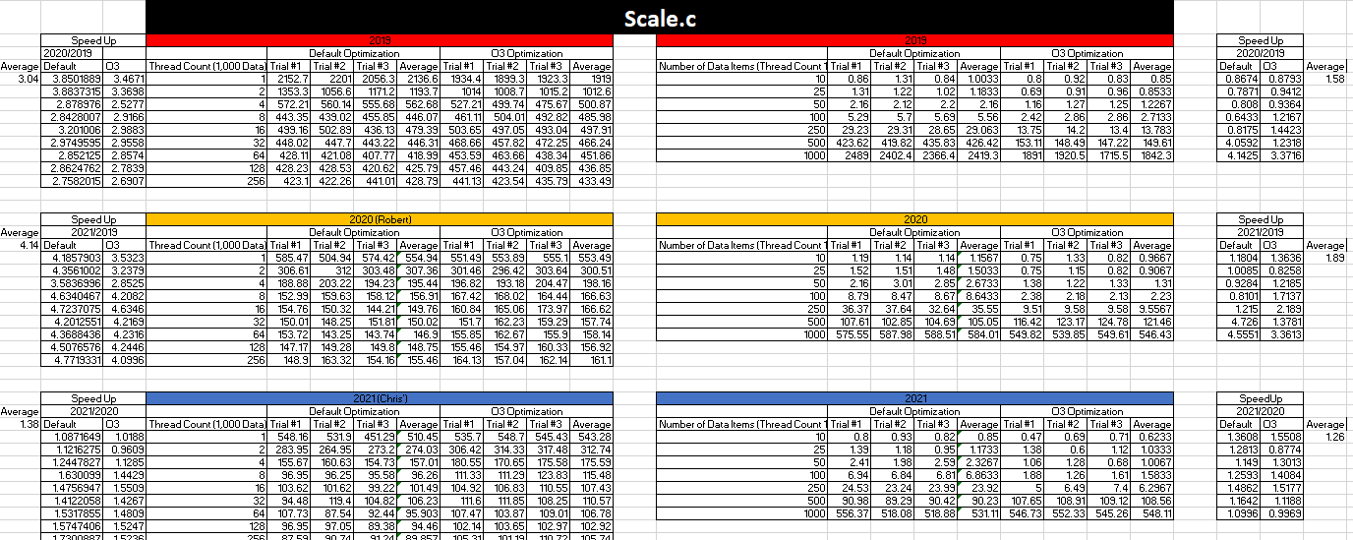
Scale.c – Excel Data

Slide 8
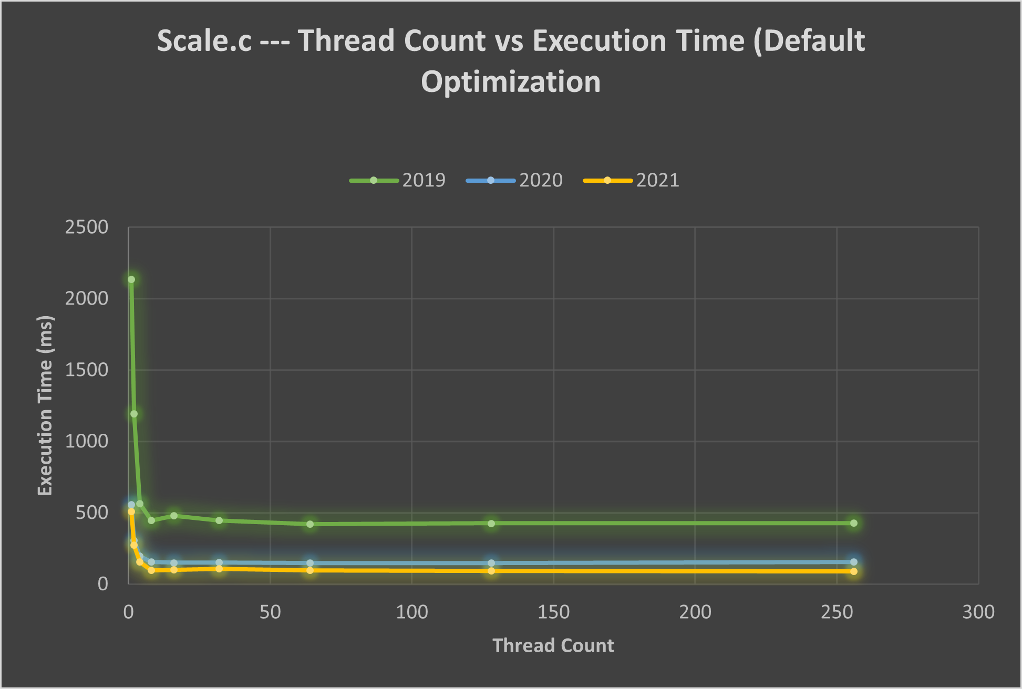
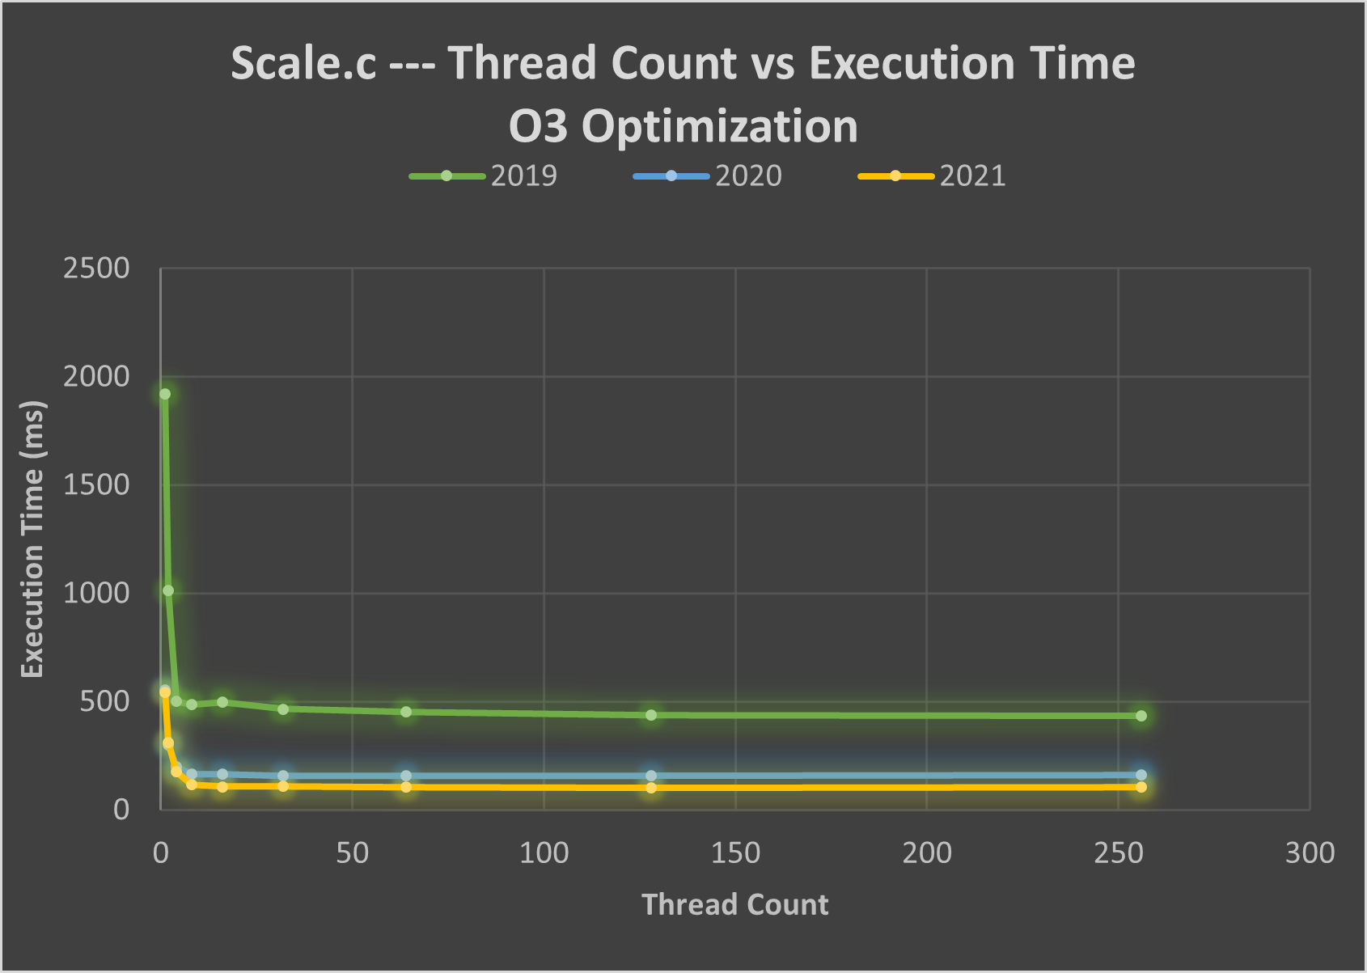
Scale.c - Data Thread Count Testing
Lower is better

Slide 9
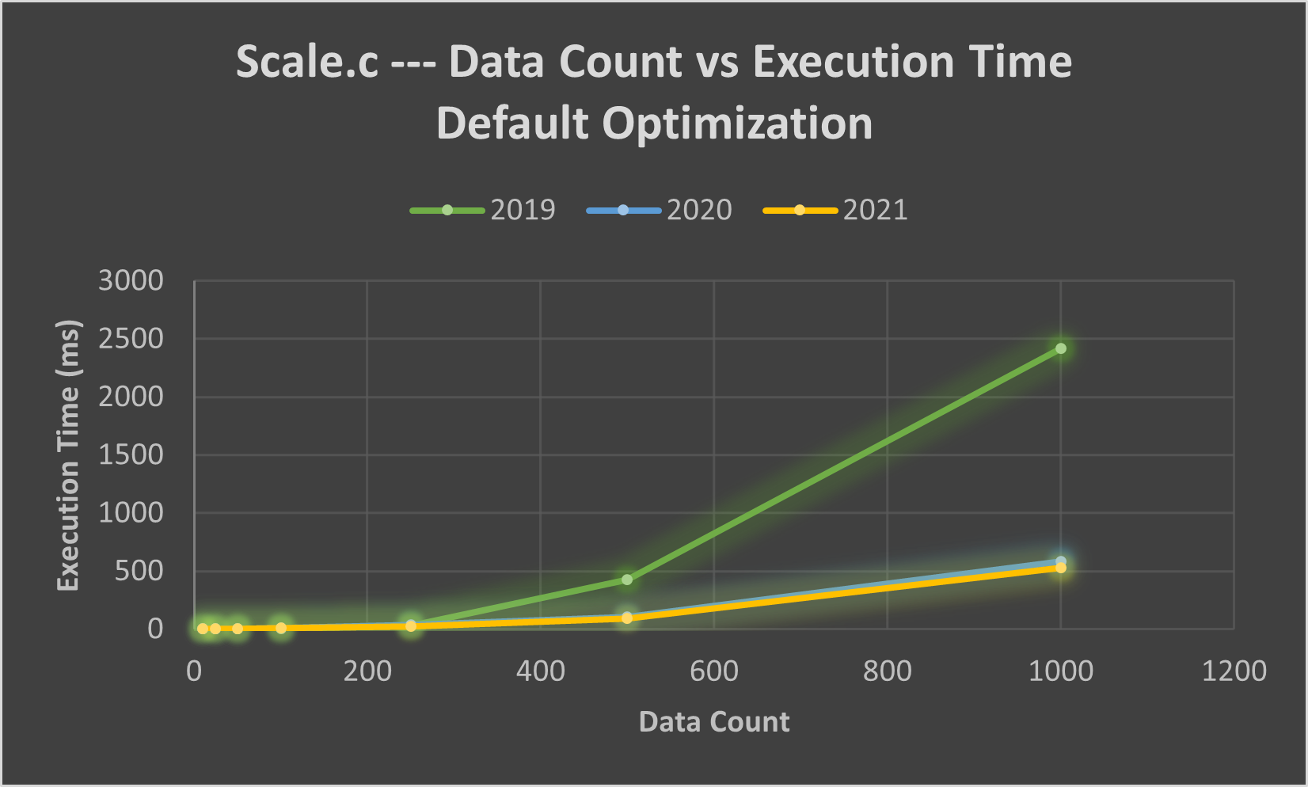
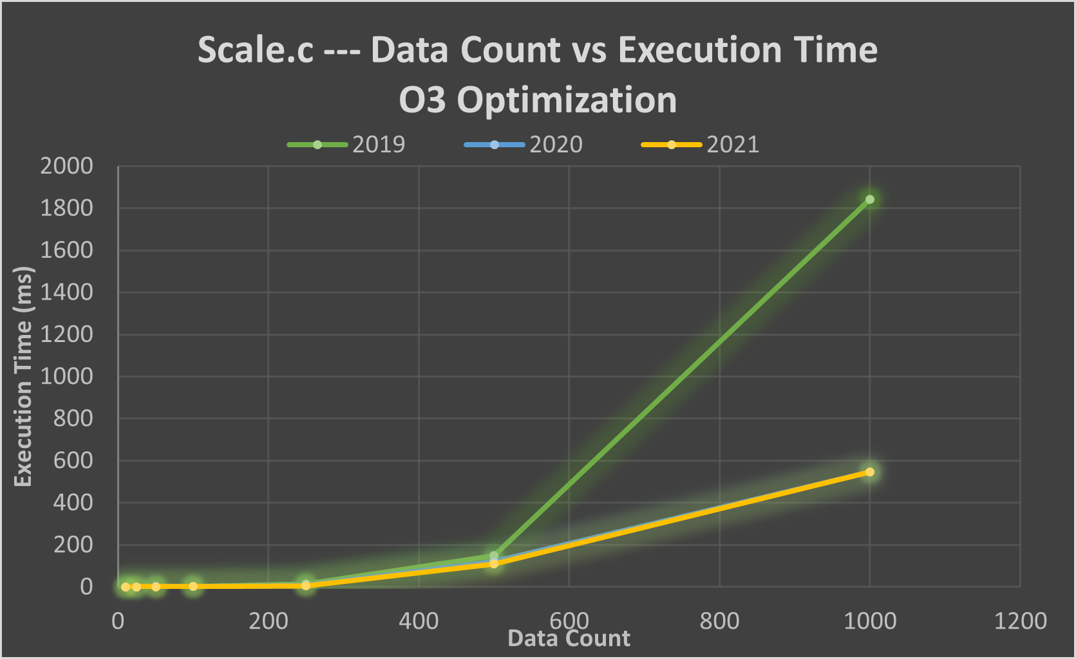
Scale.c - Data Count Testing
Lower is better

Slide 10
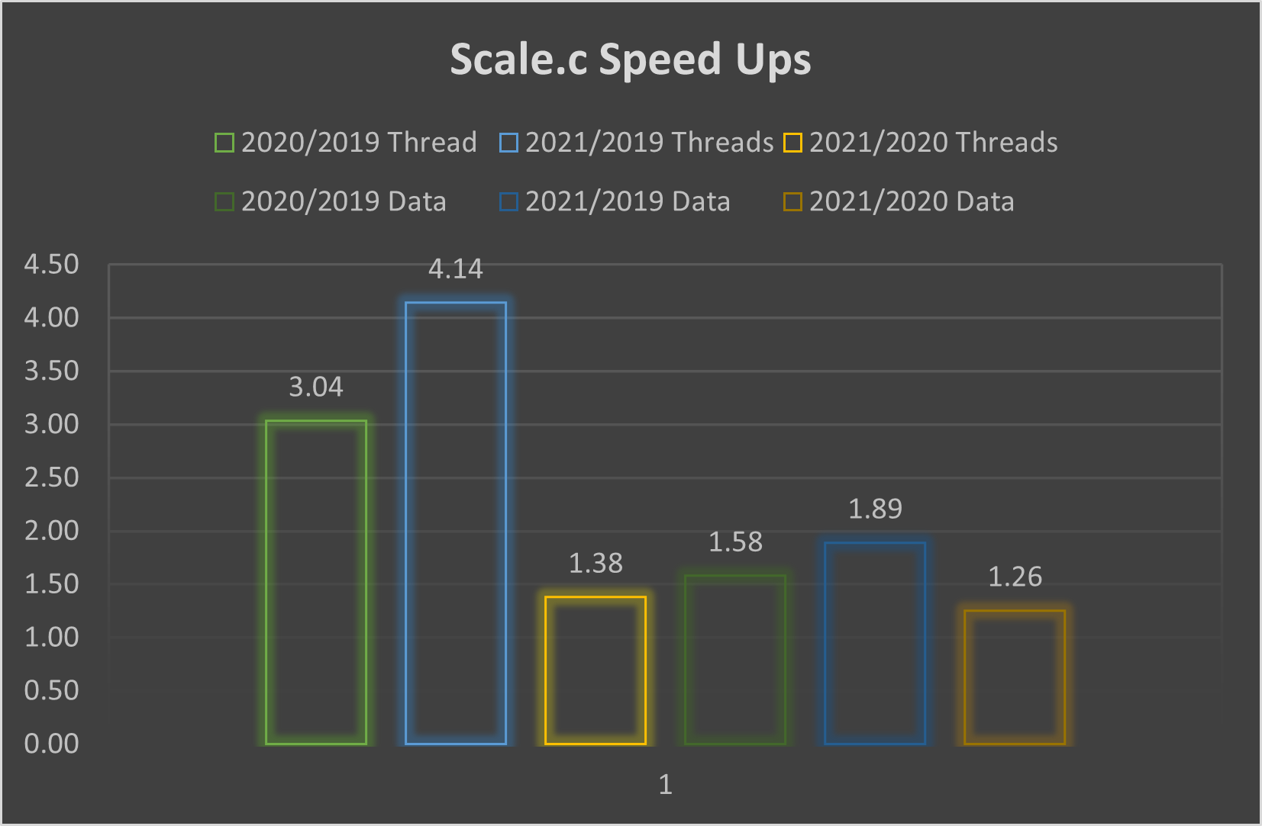
Scale.c - Speed Up Ratios (Average of All Tests)
For multi-thread testing, 2020 and 2021 (ARM) Mac laptops see significant speed-up relative to the 2019 (x86) Mac laptop. However, 2021-2020 speed up is not significant.
For single thread performance, 2021 Mac sees the greatest speed up relative to the 2019, but not significantly.

Slide 11

Minecraft Testing
A general, common day to day use case, but an intensive program.
Metrics: CPU temperatures, memory percentages, FPS.
Metric Recording Software: Stat’s Application & Minecraft’s F3 debug screen
Testing Factors: Having minimal background applications open, identical render distance settings, world seed, graphical settings, location.

Slide 12
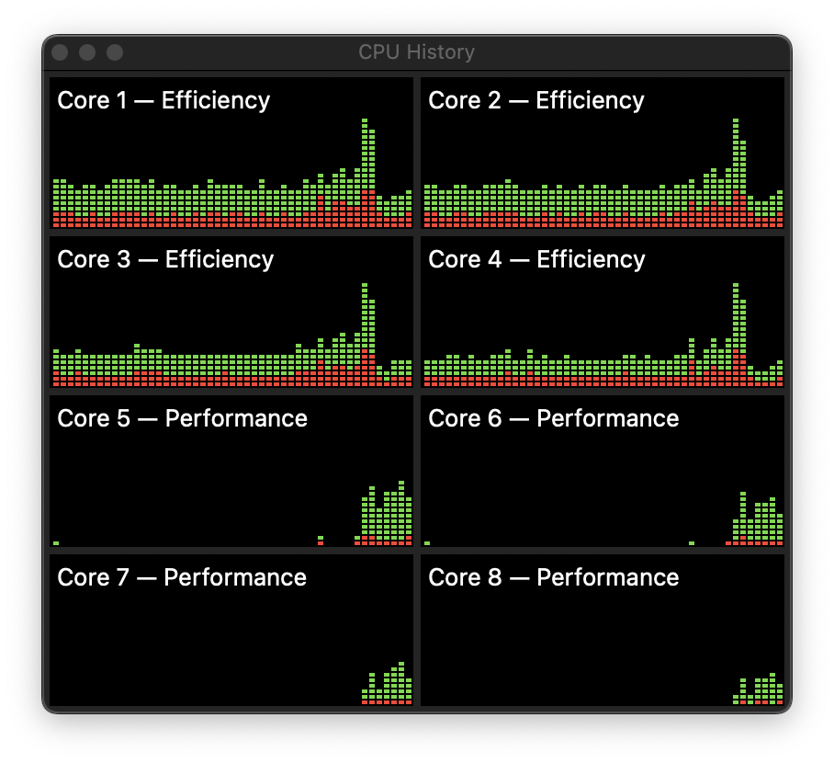
Minecraft Data thus far
A sample of Minecraft data collected on the 2020 Mac.
Lots of data to still be collected!

Slide 13
Current Thoughts on Data so Far
The switch from x86 to ARM resulted in significantly better performance
Preliminary information indicates heat is a major factor in the Minecraft test
Apple was right to drop Intel

